Slide 1
SMG General Meeting @ ASCEND
20 May 2026
Stephen Blanchette Jr., AIAA Space and Missiles Group Director
stephen.blanchette@aero.org

Slide 2
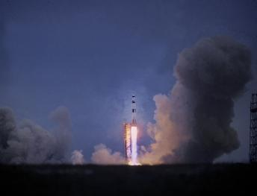


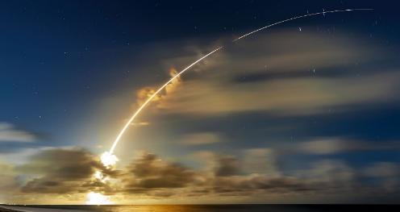


Space and Missiles Group
At the center of a New Space Age, our members transform science fiction into reality – every day
exploration, research, commerce, tourism, defense…

Slide 3

Agenda
About Me
Brief Governance Review
SMG Refresh
TAD Updates
AIAA Updates
Questions
3

Slide 4
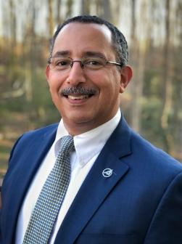
Stephen Blanchette Director, AIAA Space and Missiles Group (2026-2029)
AIAA Fellow; continuous AIAA membership since college
Former Deputy Director of the Information Systems Group
Long-time member of the Software TC, including deputy chair
Charter member of Netcentric Ops PC, Aerospace Cybersecurity WG, & Defense WG
Various conference roles, including SciTech program committee 2018/2019
BS, Computer Science from Embry-Riddle
MA, Diplomacy from Norwich University
Additional graduate certificates from UC Santa Cruz, University of Pittsburgh, and Carnegie Mellon University
Entire career in the Aerospace and Defense Industry
Software Engineer, Software Manager, Business Developer, Acquisition Specialist & Consultant
Currently, Director of Software Systems & Acquisition at The Aerospace Corporation

Slide 5
SMG Director’s Priorities – 2026
Complete the refresh of our space-related TCs
Continue improving TC connections to planning for SciTech, DEFENSE, and, especially, ASCEND
Succession planning for next SMG Director (2029-2031)
Have been sounding out/encouraging past TC chairs
Have been dropping hints at every TC meeting I’ve attended
Want at least two viable candidates
Interested? Talk to me!
5
5

Slide 6
AIAA Governance Overview
6

Slide 7
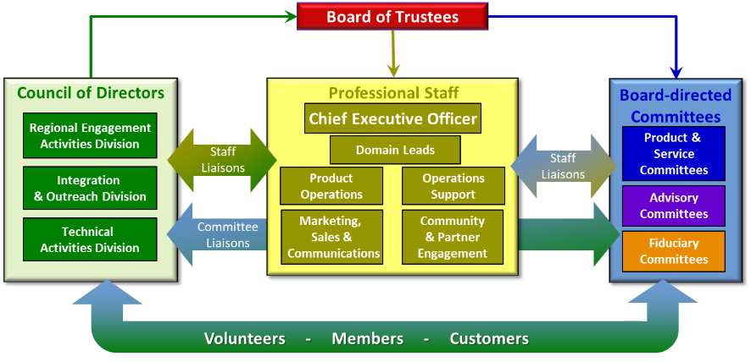
Governance Model (Stephen’s Bootleg Version)
Paid professional staff – AIAA is their day job
Aerospace Community
Industry (Large & Small Business)
Government
Academia
Not-for-Profit R&D
* TAD * Our TCs and Groups live here
7
7

Slide 8

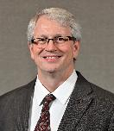


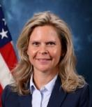

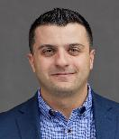


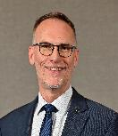

2026-2027 TAD Leadership Team
Aerospace Design and Structures
Dawn Phillips
NASA Marshall
Space Flight Center
2024-2027
Information Systems
Michel Ingham
NASA JPL
2025-2028
Division Chief
Rick Mange
Lockheed Martin
2026-2029
Technical Integration Subcommittee
Tom Smith
The Boeing Company
Aerospace Sciences
Martiqua Post
US Air Force Academy
2024-2027
Propulsion and Energy
Rusty Powell
Astrion
2025-2028
Director,
Technical & Integration Communities
Michael Lagana
AIAA
Forums Integration Subcommittee
João Luiz Azevedo
Instituto de Aeronáutica e Espaço
Aircraft Technology, Integration and Operations
Gabriele Enea
MIT Lincoln Laboratory
2026-2029
Space and Missiles
Stephen Blanchette
The Aerospace Corporation
2026-2029
8

Slide 9
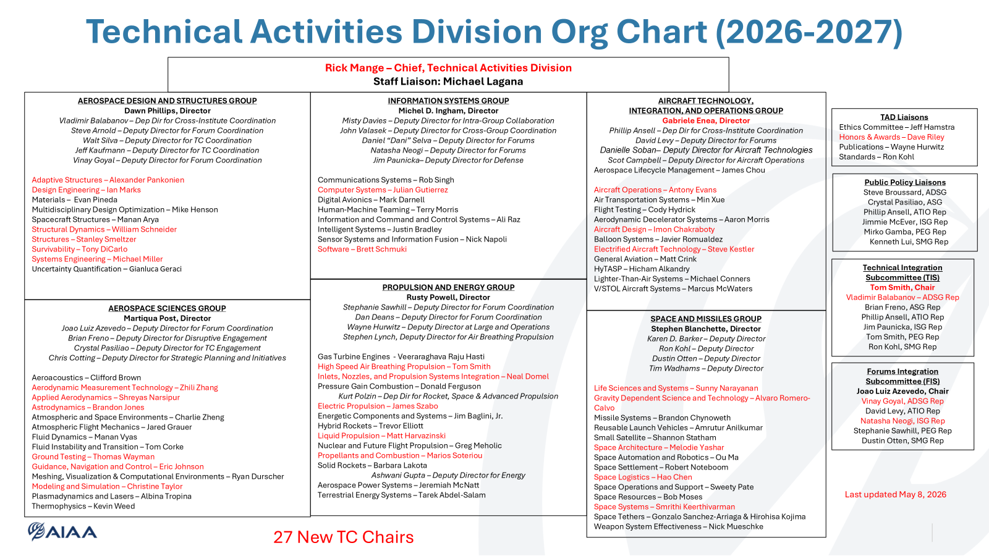
9
9

Slide 10
Many Thanks to our Outgoing TC Chairs
Eleonora Botta – Space Tethers TC
John Carsten – Space Systems TC
Samantha Chapin – Space Automation and Robotics TC
Paul Grogan – Space Logistics TC
Ken Lui – Gravity Dependent Science and Technology TC
Georgi Petrov – Space Architecture TC
Chris Nie - Life Sciences and Systems

Slide 11
SMG Space-Related TC Refresh
11
11

Slide 12
“Now is the time. The future is here… Space is on the front page every day.”
Clay Mowry, ASCENDxTexas, February 2026

Slide 13
TC Refresh: Objective and Rationale
Objective:
Modernize space-related technical committees (TCs) to address contemporary challenges
Rationale:
Current TCs do not fully align with emerging industry needs and directions
Opportunity to improve efficiency and engagement within the technical community and to attract & engage future generations
13
13

Slide 14
TAD Expectations for TCs
“AIAA Technical Committees consist of worldwide experts in their fields who help develop, support, and administer AIAA products and services, including conferences, publications, awards, and student design contests”
TAD expects TCs to exhibit the following characteristics:
Have an up-to-date charter with well-defined and bounded scope that does not significantly overlap other AIAA committees
Be at, or near, 50-member capacity
Most members active
Regular roster pruning
Engaged leadership with succession planning
Hold regular meetings several times per year
Have an efficient—and active—sub-committee structure
Be an active participant in one or more AIAA Forums (conference planning, content solicitation, abstract reviews, session chairing, etc.)
Be responsive to annual tasking (Year-in-Review articles, annual reports, roster updates, etc.)

Slide 15
Space TC Refresh: Where We Are Now
Conducted a workshop at ASCEND with TC Chairs/Vice Chairs, SMG Deputy Directors, and selected stakeholders from across the Institute (TAD leadership, IOD leadership, AIAA staff)
Discussed issues with current TC structure and TC health
Brainstormed ideas about potential new topic areas of interest
Conducted follow-up sessions in September and December with the same invitees
Reviewed the scope, charter, and activities of each TC
Identified areas of overlap/synergy
Looked at the status of our national-level awards
Identified the necessary changes, socialized plans with Chairs, CoD, BoT
Next Step: Implement!
15
15

Slide 16
SMG is Stepping into the New Space Era
YESTERDAY’S SMG
Life Sciences & Systems
Gravity Dependent Science & Technology
Reusable Launch Vehicles
Small Satellite
Space Architecture
Space Automation & Robotics
Space Logistics
Space Operations & Support
Space Resources
Space Settlement
Space Systems
Space Tethers
Space Transportation
Missile Systems
Weapon System Effectiveness
TOMORROW’S SMG*
Cislunar & Lunar Surface Exploration*
Communications and Space Data Infrastructure*
Earth and Planetary Sensing and Applications*
Gravity-Dependent Sciences and Technology
Spacefaring Health and Performance
In-Space Servicing, Assembly & Manufacturing*
Launch Vehicle and Entry Systems
Mission Operations, Rendezvous and Rescue
Small Satellites, Constellations and Commoditized Systems
Space Architecture and Habitats
Space Domain Awareness and Orbital Sustainability*
Space Industrial Logistics and Manufacturing
Space Resources Exploitation
Space Settlement
Missile Systems
Weapon System Effectiveness
Not reflective of current priorities in the space realm
Terse and opaque names obscure intent & breadth of scope
Reliance on the adjective “Space” as an organizing principle
Flat, unexciting, uninteresting
Better aligned to current & near-future challenges in space
Engaging, pithy names better capture intent and scope (and the imagination!)
Technical areas oriented toward missions & outcomes – “Space” no longer the dominant organizing principle
* Items in Gray are for future discussion

Slide 17
We’re Mapping Old Space to New Space
EXISTING SPACE TCs (13)
Gravity Dependent Science and Technology TC
Life Sciences and Systems TC
Reuseable Launch Vehicles TC
Small Satellite TC
Space Architecture TC
Space Automation and Robotics TC
Space Logistics TC
Space Operations and Support TC
Space Resources TC
Space Settlement TC
Space Systems TC
Space Tethers TC
Space Transportation TC
TAD/ISG
PROPOSED SPACE TCs (9)
Gravity-Dependent Sciences and Technology (GDST TC)
Spacefaring Health and Performance (SHP TC)
Launch Vehicle and Entry Systems (LVES TC)
Mission Operations, Rendezvous and Rescue (MORR TC)
Small Satellites, Constellations, and Commoditized Systems (SSCCS TC)
Space Architecture and Habitats (SAH TC)
Space Industrial Logistics and Manufacturing (SILM TC)
Space Resources Exploitation (SRE TC)
Space Settlement (SpSet TC)
AIED
TAD/PEG
POSSIBLE GAPS FOR FUTURE CONSIDERATION
Cislunar & Lunar Surface Exploration
Communications and Space Data Infrastructure
Earth and Planetary Sensing and Applications
In-Space Servicing, Assembly & Manufacturing
Space Domain Awareness and Orbital Sustainability
TAD/ISG

Slide 18


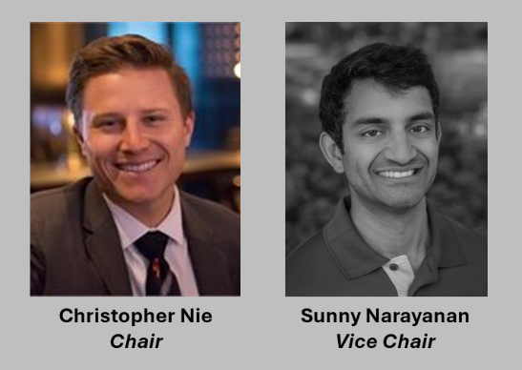
Spacefaring Health & Performance (SHP TC)
Advances the science, engineering, operational methods and standards required to protect, sustain, and optimize human life and performance in space environments. Areas include radiation protection, human physiology, behavioral health, crew systems and habitability, life-support and environmental control systems, medical care and training, safety and risk mitigation, and performance in extreme and long-duration missions across LEO, lunar, and deep-space missions.
Distinct from gravity-dependent physical/biological sciences and manufacturing
Coordinates with Space Architecture & Habitats on built-environment interfaces and with Mission Operations Rendezvous and Rescue on procedures and training

Slide 19

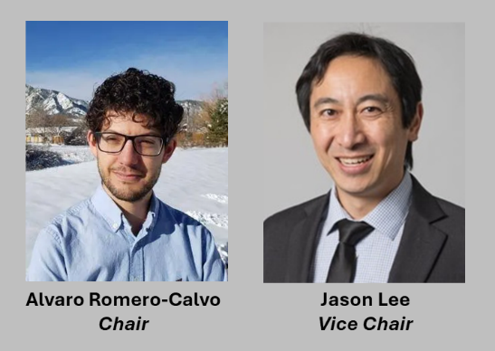
Gravity-Dependent Sciences and Technology (GDST TC)
Advance microgravity and partial-gravity science and their applications to materials, physical, and biological processes and in-space manufacturing that depend on the gravity regime. Encompasses experiment design, flight platforms and payloads, process modeling, and validation for pharmaceutical, crystal growth, additive manufacturing, and advanced materials.
Excludes crew biomedical policy and human-systems integration (addressed by Spacefaring Health and Performance) and excludes mission operations execution (addressed by Mission Operations Rendezvous and Rescue)

Slide 20
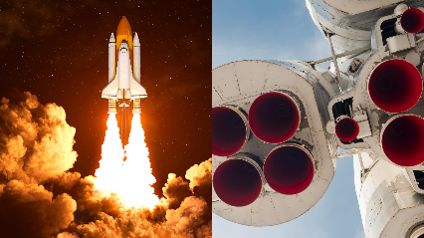
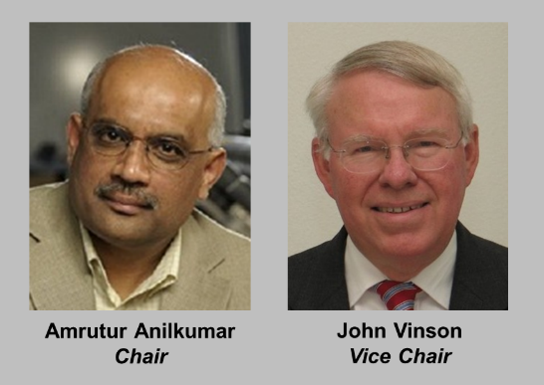
Launch Vehicle and Entry Systems (LVES TC)
Promote the development and implementation of operationally responsive and economically viable commercial, military, and civil space transportation for crewed and uncrewed missions including reusable and expendable launch vehicle stages, entry, descent and landing systems, crew capsules, spaceplanes, in-space tugs, abort/escape systems, range/spaceport, and certification. Covers enabling technologies such as TPS, aerocapture, and advanced concepts as part of vehicle systems.
Operations execution and proximity operations remain with MORR
Collaborates with PEG, ASG, ADSG on cross-cutting concerns

Slide 21

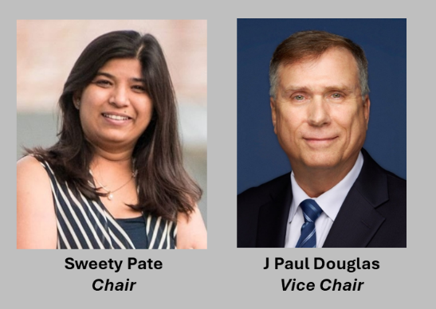
Mission Operations, Rendezvous, and Rescue (MORR TC)
Advance concepts of operations, mission planning, flight dynamics, telemetry/command, onboard/ground data handling, autonomy (as applied to operations), and decommissioning. Focuses on rendezvous, proximity operations, docking/berthing, in-space assembly servicing execution, contingency ops, and emergency response/space rescue architectures and procedures.
Interfaces with LVES on vehicle capabilities and with SILM on OSAM-related logistics architectures
Collaborates with ISG on application of AI/ML to mission operations

Slide 22

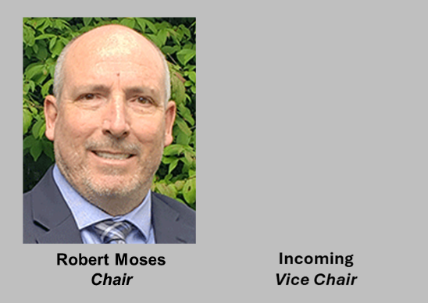
Space Resources Exploitation (SRE TC)
Advance the science, technology, and systems to identify, extract, process, store, and apply resources from the Moon, Mars, asteroids, and other celestial bodies to support sustained human and robotic missions and infrastructure. The scope includes resource prospecting and in-situ characterization; tailored extraction and processing methods for producing propellants, consumables, and construction materials; and system development from design through analog, laboratory, flight demonstrations, and large-scale operations. It also encompasses the integration of ISRU-derived products into depots, supply-chain nodes, and inventory management systems, alongside design principles for interoperability, maintainability, and circularity. Sustainability, planetary protection, and responsible utilization are core considerations.
Habitat design remains with SAH TC.

Slide 23
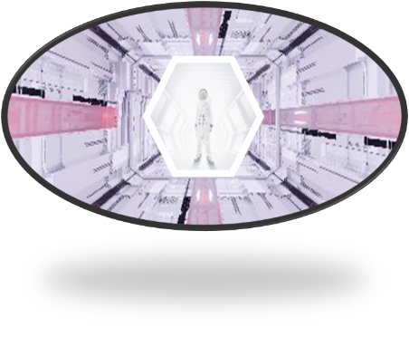
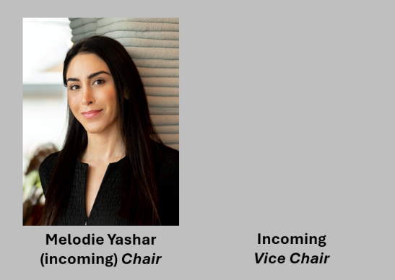
Space Architecture and Habitats (SAH TC)
Advance the architectural design of living and working environments in space vehicles, stations, surface outposts, and future settlements. Emphasizes safety, habitability, human reliability, crew productivity, manufacturability, modularity, and integration with ISRU-derived materials and OSAM build methods. Includes relevant terrestrial analogs, standards development, and long-term architectural planning for scalable, multi-phase habitation systems that can evolve from outposts to permanent settlements.
Biomedical and human performance research remains with SHP
Logistics and supply-chain strategies remain with SILM
Collaborates on habitat design with SpSet, on operational concepts for use with MORR, and on survivability and performance issues with SHP

Slide 24

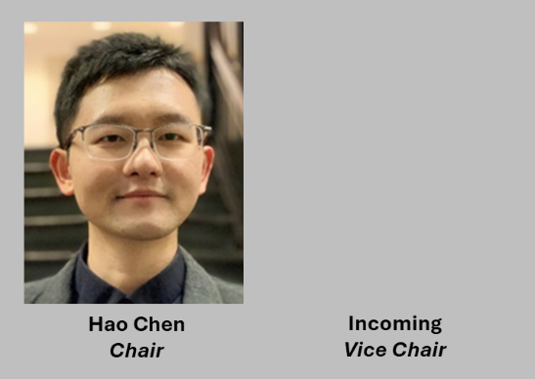
Space Industrial Logistics and Manufacturing (SILM TC)
Advance logistics architectures, industrial systems, and manufacturing technologies that enable sustainable, scalable space operations and commercial activity from Earth orbit to cislunar space and beyond. The scope includes end-to-end logistics planning and campaign analysis; supply-chain architectures with depots and distribution nodes for propellants, consumables, spares, and feedstocks; lifecycle management and design-for-commonality; interoperability and standardization across commercial and government systems; and techno-economic assessment of industrialization pathways. The TC’s core identity centers on systems engineering for space-based supply chains and industrial ecosystems operating at scale.
SILM covers the integration of ISRU-derived inputs into manufacturing and logistics networks, while ISRU extraction and processing remain with SRE, rendezvous and proximity operations with MORR, and vehicle system design and transportation with LVES
Interacts with other TCs and AIECs to ensure supportability concepts permeate across all focus areas

Slide 25

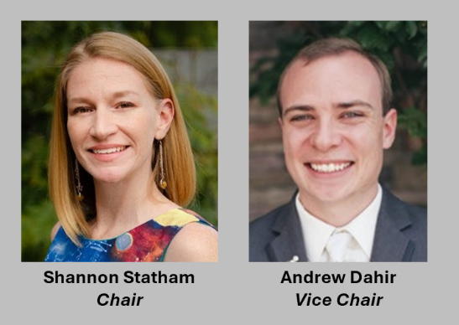
Small Satellites, Constellations, and Commoditized Systems (SSCCS TC)
Advance design, manufacturing, testing, and operations at scale for CubeSats through microsats and proliferated constellations. Emphasizes modular/open architectures, hosted payloads, rideshare/multi-manifest integration, supply chains, ground automation for fleet ops, reliability at scale, and commercialization/commoditization practices.
Mission-specific payloads and applications reside in other TCs
Collaborates with LVES on commoditized launch and integration with launch systems
Comms/PNT networks and ground data centers are in the purview of CSDI (or equivalent) in ISG

Slide 26


Space Settlement (SpSet TC) [P*]
Further the long-term expansion of the human species beyond Earth's atmosphere, as an opportunity and benefit for humans of all genders, races and creeds. Space Settlement includes free-floating habitats and habitats on planetary bodies including the Moon, Mars, asteroids, or others. In the pursuit of space settlement, Earth will benefit as well.
Focuses on the needs of humans living off-Earth
Collaborates on habitat design with SAH, on operational concepts for living with MORR, and on survivability and performance issues with SHP
[P*] = Probation

Slide 27
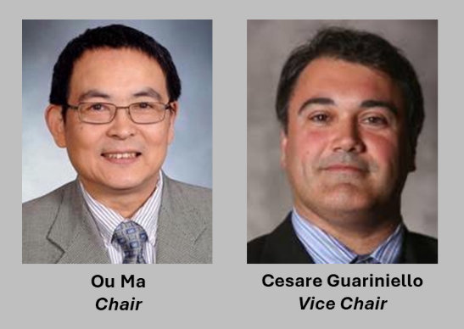
Moving to TAD/ISG
Space Automation and Robotics TC
Addresses the science, engineering, and application of automation and robotic systems for space missions across Earth orbit, cislunar space, planetary environments, and deep space. The scope covers all aspects of robotics including sensing and perception, guidance, navigation and control, manipulation and mobility, artificial intelligence and decision making, system dynamics, modeling and simulation, and human–autonomy interaction, as well as system-level aspects such as architecture, verification and validation, safety, reliability, and mission operations.

Slide 28
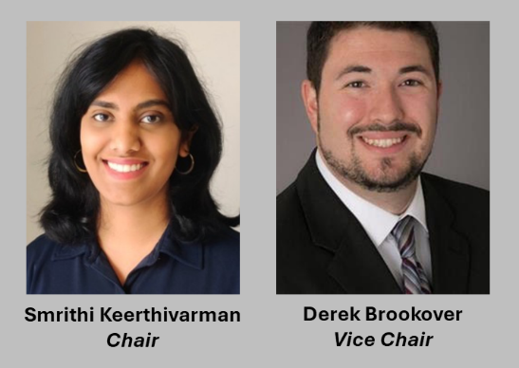
Moving to AIED
Space Systems TC
Fosters the development, application, and operation of general space systems, and addresses and provides informed positions on emerging space system issues. Interests and activities range from science and technology to program management to policy

Slide 29
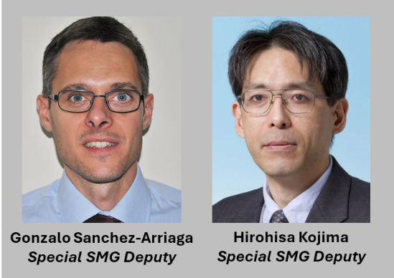
Sunsetting
Space Tethers TC
Active members whose interests include power and propulsion applications will transfer to the Propulsion and Energy Group (PEG)
Active members whose interests include space debris removal applications will have the opportunity to participate in standing up Space Domain Awareness and Orbital Sustainability (SDAOS)
Chair & Vice Chair, Gonzalo Sanchez-Arriaga and Hirohisa Kojima, become special SMG Deputies, responsible for facilitating transition of members (including themselves) and technology to their new homes
Tethers are an important part of the AIAA technical community, just not as a standalone entity

Slide 30
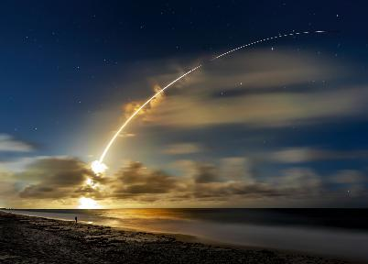
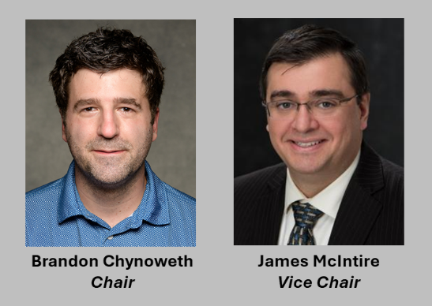
Missile Systems TC (No Change)
Promotes engineering and rationale for development and operation of tactical and strategic, offensive, and defensive missile systems.

Slide 31

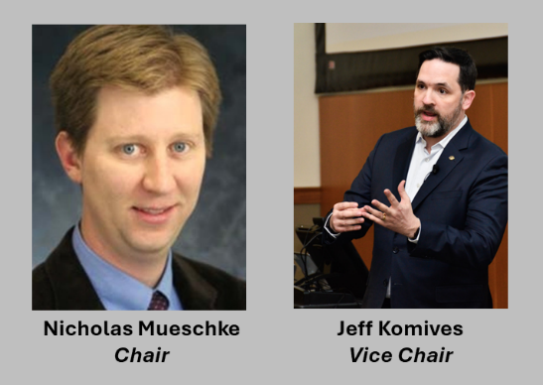
Weapons Systems Effectiveness TC (No Change)
Develops and promotes the science and technology of predicting, measuring, evaluating, and improving the lethality, or effectiveness, of weapon systems.

Slide 32





































The Refreshed SMG
Spacefaring Health & Performance
Launch Vehicle and Entry Systems
Group Director & Deputies
Blanchette
Nie
Narayanan
Anilkumar
Vinson
Gravity Dependent Science and Technology
Space Architecture and Habitats
Photo Not Avail
Romero-Calvo
Lee
Yashar
Incoming
Small Satellites, Constellations, & Commoditized Systems
Space Industrial Logistics and Manufacturing
Photo Not Avail
Barker
Kohl
Otten
Wadhams
Statham
Dahir
Chen
Incoming
Mission Operations, Rendezvous, and Rescue
Space Resources Exploitation
Photo Not Avail
Sanchez-Arriaga
Kojima
Pate
Douglas
Moses
Incoming
Missile Systems
Weapon System Effectiveness
Space Settlement
Mueschke
Komives
Chynoweth
McIntire
Noteboom
Bruce

Slide 33
We Have a Phased Implementation Plan
Phase 1:
Re-charter existing TCs
Shift people as needed
Begin executing in the new construct by late summer 2026
Phase 2:
Consider how to address potential gaps
Prioritize the list
Determine if scope is partially addressed anywhere (TAD or AIED)
Canvass for interest within the volunteer community
Determine appropriate format (TC, Working Group, etc.)
Determine appropriate home (specific group within TAD or AIED)
Develop a plan for moving forward by the end of 2026

Slide 34
TAD Expectations for TCs
“AIAA Technical Committees consist of worldwide experts in their fields who help develop, support, and administer AIAA products and services, including conferences, publications, awards, and student design contests”
TAD expects TCs to exhibit the following characteristics:
Have an up-to-date charter with well-defined and bounded scope that does not significantly overlap other AIAA committees
Be at, or near, 50-member capacity
Most members active
Regular roster pruning
Engaged leadership with succession planning
Hold regular meetings several times per year
Have an efficient—and active—sub-committee structure
Be an active participant in one or more AIAA Forums (conference planning, content solicitation, abstract reviews, session chairing, etc.)
Be responsive to annual tasking (Year-in-Review articles, annual reports, roster updates, etc.)

Slide 35
TAD Updates
35
35

Slide 36
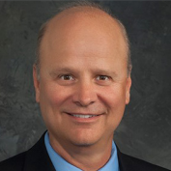
New TAD Chief
Welcome (back) Rick Mange, TAD Chief for the 2026-2029 term
Term runs from May 1, 2026 – April 30, 2029
Bio:
Currently Vice President of Lockheed Martin F-35 Engineering, formerly Chief Engineer of F-35 and several Skunk Works Programs
AIAA Fellow, 2024
Aircraft Technology, Integration, and Operations (ATIO) Group Director, 2020-2023
B.S., M.S., and Ph.D. in Aerospace Engineering from University of Illinois at Urbana-Champaign
Many thanks to Lesley Weitz for her leadership these last three years!

Slide 37
Incoming TAD Chief Vision
Continually improve the organization and the forum model (Data Driven!!)
Actively seek out and be open to feedback from TC members
Seek to understand and support the needs of our TCs
Right size and align our TCs to current-day realities
Be leaders in driving strategy, to include forums, publications, policy papers, etc
Establish and close actions to resolve forum issues such as paper withdrawals
Collaborate purposefully and professionally with the rest of the institute (Proactive!!)
Work with the TAD Group Directors to solicit new ideas and opportunities from their TCs
Provide data-driven feedback from the TCs to the Council of Directors, the Board of Trustees, and AIAA Executives and Staff to help shape our products and strategies
Actively work with READ and IOD Chiefs to find ways to collaborate in advancing the Institute
37

Slide 38
Incoming TAD Chief Vision (Cont)
Reduce administrative burden (Free up volunteers and staff for the most important work!!)
Provide and use automation/AI tools for tasks like meeting minutes, data searches and metrics
Develop a go-to list of volunteers outside of elected/selected leadership to reduce individual burdens
Limit meeting numbers and duration – meet with a purpose and end when the purpose is achieved
Grow the Institute (This is existential!!)
Clearly communicate to members and potential members the value proposition AIAA has to offer; particularly to young professionals to whom AIAA’s professional development activities can be of great value
Clearly communicate to decision makers in Government and Industry, the value proposition of enabling and encouraging young professionals to join AIAA and actively participate
Continue to enhance our Forums, to improve our members experiences and attract new members
38

Slide 39
AIAA Director’s Report
Michael Lagana
Director, Technical & Integration Communities

Slide 40
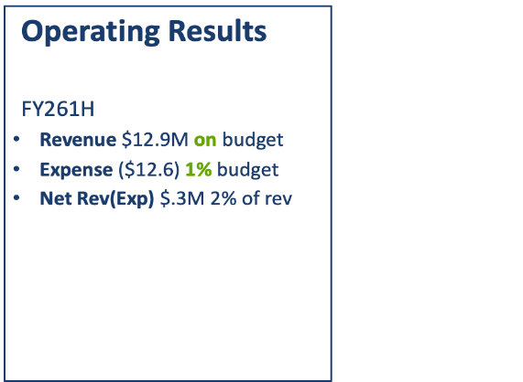
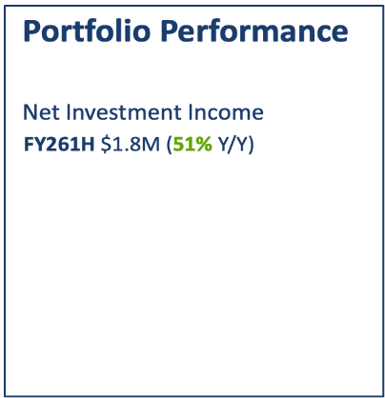
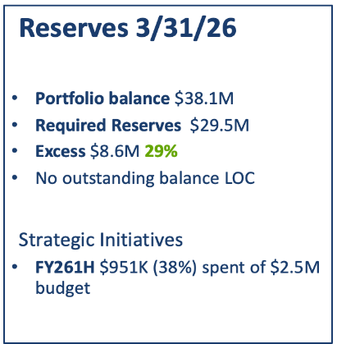
Institute Financial Update
Notes:
At the midpoint of FY26, the Institute is in a strong financial position, delivering results on budget. The Institute Portfolio continues to materially exceed required reserves and provide significant growth in investment income.
Year‑to‑date operating revenue of $12.9M is fully on budget, with overall revenue consistent with prior year when adjusted for the DEFENSE timing difference.
First half expenses totaled $12.6M, coming in 1% better than budget and included some offsetting variances. Overall spending remains aligned with FY26 budget.
The resulting Net Revenue less Expense is positive and represents 2% of revenue.
Strategic initiatives funded from the portfolio totaled $951K in the first half of FY26 (38% of the approved $2.5M FY26 strategic initiative budget). Spending focused on the AMS system and international growth priorities, including support for the IAC 2029 bid.

Slide 41
IT Survey Update
AIAA conducted an IT Survey of TCs, IOCs, Regions, and Sections (READ)
Surveys were conducted in two iterations – fall (October) and spring (February)
Purpose: to determine the priority IT focus for TCs, IOCs, and READ
Between TAD, IOD, and READ 133 responses were received
Results from the survey have informed AIAA staff IT efforts around building collaborative tools and microsites for our communities and these efforts are in progress

Slide 42
Important Dates to Remember
Recurring Deadline Cadence (These dates don't change):
New Member Cycle: 1 September – 15 October [please designate someone from your TC to review applications!]
Rosters due: 31 January
Annual Reports due: 31 January
New Rosters Effective: 1 May
Fellow/Honorary Fellow Nominations: 1 June 2026
Fellow/Honorary References: 1 July 2026
Aerospace America Year-In-Review Article due to AIAA: 1 September
SciTech Committee Room Requests:
Portal Opens: 1 August 2026
Portal Closes: 15 September 2026
SciTech Best Paper Nominations (watch your e-mails!) -
Portal Opens: 15 June 2026
Portal Closes: 1 October 2026
Notes:
Please designate someone from your TC to review membership applications, preferably your membership subcommittee chair. They can recruit 2-3 additional people to help.

Slide 43
Save the Date! New Chair Orientation
New Chairs! Please Save the Date for a new chair orientation:
Date: Wednesday, 6/24/2026
Time: 12:00pm ET/9:00am PT
Via Zoom
Invitation to be sent to all TC Chairs, new and experienced – come one, come all!
Topics we'll discuss -
The Rostering process
New Member Applications
The importance of your charter and business manuals
Meeting cadence
Staff Organization
Volunteer leader fiduciary responsibility

Slide 44


AIAA Open Volunteer Positions – We Need You!
ATIO Deputy Forum Technical Chair – AVIATION 2027
PEG Deputy Forum Technical Chair – AVIATION 2027
Interested? Have questions?
Contact Michael Lagana | michaell@aiaa.org OR
Kim Grant | kimg@aiaa.org
Notes:
We are looking for volunteers to help serve as Deputy Forum Technical Chairs (FTC) for AVIATION 2027. The FTCs are responsible for coordinating the overall technical program, including ensuring all participating TCs have representation, managing session room allocations, and resolving scheduling conflicts across the program. Within their Group/IOD, FTCs help guide Deputy FTCs, assist with the Call for Papers process, and monitor progress on paper reviews, decisions, and session development. Please reach out to Michael Lagana if you are interested in serving as the Deputy for one of these areas in 2027 – with the position then serving as Forum Technical Chair in 2028.

Slide 45
BONUS: DEFENSE Forum Call for Technical Briefings
All technical communities are welcome to submit abstracts or session ideas through the call for briefings.
SUBMIT HERE
Questions? Contact conferences@aiaa.org

Slide 46
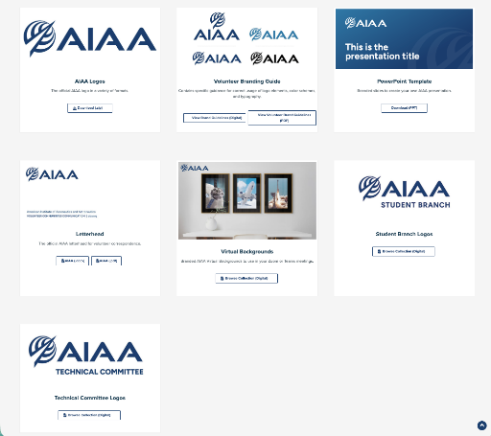
AIAA Brand Center
Everything you need for branding and communications, in one place.
TC Logos
PowerPoint Templates
Zoom backgrounds
A full branding guide
...and much more
CLICK HERE

Slide 47
AIAA Updates
47
47

Slide 48
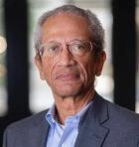


AIAA President
Transition to new President occurred earlier this week
Daniel E. Hastings
Cecil and Ida Green Education Professor of Aeronautics and Astronautics
Massachusetts Institute of Technology
Dana “Keoki” Jackson, Sc.D.
Senior Vice President, General Manager MITRE National Security
The MITRE Corporation
48
48

Slide 49

AIAA Events Staff Updates
Chelsey Wiley, Content Manager, R&D and National Security
Joined in early April
Will be working with TAD and IOD on SciTech, DEFENSE, the CTO Summit, and the classified day at ASCEND
She replaced Alex Mercer
Contact her at chelseyw@aiaa.org
Regan Patrick, VP of R&D and National Security, left at the end of April
We are actively hiring for a Senior Director, R&D and National Security
Please share! https://aiaa.applicantpro.com/jobs/4055309

Slide 50
IOD Reorganization Resolution Support Information
Dr. Jeanette Domber, IOD Chief April 20, 2026

Slide 51
Governance Model (Stephen’s Bootleg Version)
Aerospace Community
Industry (Large & Small Business)
Government
* IOD *
Academia
Not-for-Profit R&D
51
51

Slide 52
Reorganization Rationale
IOD transforms to AIED
An IOD reorganization clarifies roles and responsibilities among the volunteers and how they connect to staff so that discipline-based technical depth remains with TAD while cross-cutting integration, mission focused scope, emerging themes, and outward facing engagement are strengthened within the Aerospace Integrated Engagement Division (AIED, pronounced AID).
We focused on alignment, governance clarity, and strategic positioning in considering how to reorganize IOD
When someone who is not familiar with AIAA looks for participation opportunities, this reorganization makes it clearer where to start
We moved committees or groups closer to their Institute level decision making where they may have greater influence as appropriate

Slide 53
Mission Updated to Reflect Intent of the Division and Promote Cohesiveness Amongst its Groups
Mission Statement:
The Aerospace Integrated Engagement Division connects cross-cutting aerospace initiatives that span technology, operations, and societal impact, fostering collaboration and integrative thinking to address emerging challenges and guide the evolving aerospace ecosystem.
Tag-Line:
Connecting ideas, disciplines, and communities to shape the future of aerospace.

Slide 54
Aerospace Integrated Engagement Division Org Chart
Does not reflect roster updates that will take affect in May
Jeanette Domber – Chief, AIED (2025-2028)
Sofia Russi – Deputy Chief, AIED
Staff Liaison: Michael Lagana
AEROSPACE IN SOCIETY GROUP
Sofia Russi, Director (2025-2028, 1st term)
Matt Cannella, Deputy Director
History – John Tylko
Management* – Sivaram Gogineni
Society and Aerospace Technology – Chi Mai
Sustainability – Phillip Ansell
Realign with Other Parts of AIAA
Convert WoAA to Affiliated Society
Convert to Board advisory groups:
Young Professionals
International Activities
ADVANCED FLIGHT & INTEGRATED OPERATIONS
Abdollah Khodadoust, Director (2025-2028, 1st term)
Gaudy Bezos-O'Connor, Deputy Director
Aerospace Traffic Management – Karl Garman
Aviation in Multimodal Transportation – Husni Idris (2026-2028)
Supersonics – Darcy Allison
Transformational Flight – Cedric Justin
Uncrewed and Autonomous Systems – Devin Jack
DEFENSE, SECURITY, & INTELLIGENCE GROUP
TBD, Director
Airborne Directed Energy Systems – John Ehrhart
Unidentified Anomalous Phenomena – Ryan Graves
Domain Mapping Legend
Aeronautics
Defense/National Security
Research & Development
Space
SPACE SYSTEMS & EXPLORATION
TBD, Director
Space Exploration – Surendra Sharma
DIGITAL SYSTEMS & INTEGRATION GROUP
TBD, Director
CFD Vision 2030 – Andrew Cary
Digital Engineering – Olivia Pinon Fischer
*Sunset Economics and Legal Aspects of Aeronautics & Astronautics based on committee health assessments; these committees can always reapply to form anew.
54

Slide 55
AIED Short Group Descriptions
Aerospace in Society: Explores aerospace through societal impact and historical perspectives, integrating technical insight with policy and public engagement to help guide responsible and forward-looking directions for the aerospace enterprise.
Defense, Security, & Intelligence: Integrates cross-domain aerospace perspectives related to security, safety, and emerging capabilities, fostering collaboration among experts and external stakeholders to address evolving strategic and mission challenges unique to the Defense and Intelligence communities.
Digital Systems & Integration: Advances the integration of digital engineering, computational methods, and data-driven practices to enable more connected, collaborative, and efficient development and operation of aerospace systems.
Advanced Flight & Integrated Operations: Examines emerging flight concepts and evolving operational frameworks, integrating technology, autonomy, and transportation systems to shape the future of aeronautical operations.
Space Systems & Exploration: Promotes integrative approaches to the system of systems for science and exploration, connecting mission innovation, technical collaboration, and expanding partnerships across the space ecosystem.

Slide 56
Defense Working Group
Jimmie McEver, Dustin Otten, Allison Cash
May 18, 2026

Slide 57
AIAA Defense Working Group
Emerging activity – in formative/stand-up phase
The AIAA Defense Working Group advocates for and facilitates collaboration across all AIAA Technical Committees (TCs) and between TCs and key DoD organizations on US national security topics and in particular on US DoD-related interests
Action-level engagement between TCs and DoD organizations to enhance contributions of AIAA technical communities to national security needs
Grow TCs awareness of DoD leaders and challenges
Grow DoD awareness of AIAA technical competence
Comprised of representatives across interested AIAA technical committees
Build battle rhythm of conversations with DoD technical leaders

Slide 58
Defense WG Objectives
Establish and maintain relationships between AIAA TCs working on defense related topics and the associated DoD organizations to ensure and enhance understanding of technology roadmaps and emerging requirements.
Position AIAA to help address emerging requirements; inform industry of DoD priorities and need for investment.
Enhance DoD awareness of and access to subject matter experts and leading edge technical research through AIAA technical committees.
Create and execute an Excellence in Defense Award to be presented annually at the AIAA Defense Forum.
Identify AIAA conferences/forums that can support ITAR and classified content (DEFENSE, …) and provide technical planning support to connect authors, speakers and content providers with the appropriate conference venue
Meet and discuss US DoD priorities and interests with OSD leadership and other government stakeholders.
Support development of AIAA position papers on defense related topics for Congressional Visits Day (CVD). Coordinate position papers and congressional interaction with the AIAA Public Policy Committee, and inform the Committee on technical topics and challenges emerging from TC/DoD engagement.
Organize workshops/town halls/roundtables for industry and DoD organizations to collaborate outside of the acquisition process.

Slide 59
WG Requests
Hold ”agenda-setting” virtual meeting to identify high-priority defense topics for AIAA technical community
Projected June-July 2026, after AVIATION
Conduct survey of TC defense-related work, products, and interest
Construct AIAA “yellow pages” for national security related expertise and products
If you would like to take on an active role in the Defense WG, or would like to nominate TC members to connect, please contact me at jimmie.mcever@jhuapl.edu

Slide 60
2026 Forums Update
60
60

Slide 61
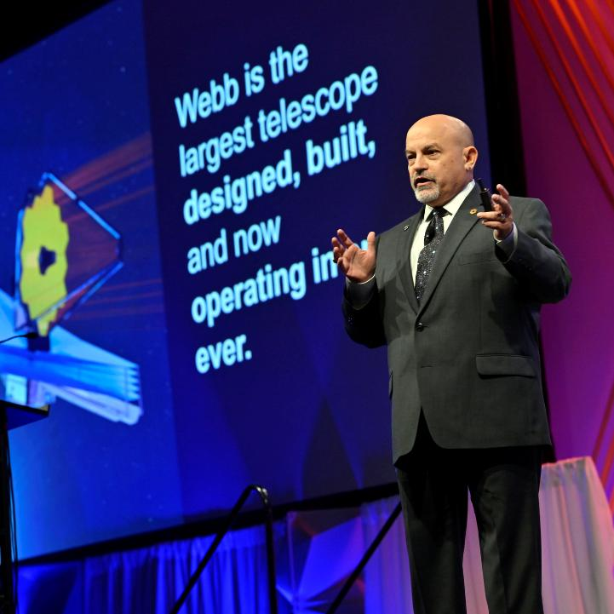
SciTech Forum 12–16 January, Orlando, Florida
Call for content: Abstracts +6%, Sessions +10% over 2025
2914 technical presentations +1.8% over 2025
731 technical sessions:
25 lectures
61 panels
635 paper sessions
10 workshops
5950 attendees -3% over 2025
2146 students (most ever!)
Exhibits and Sponsorships: +30% over 2025

Slide 62
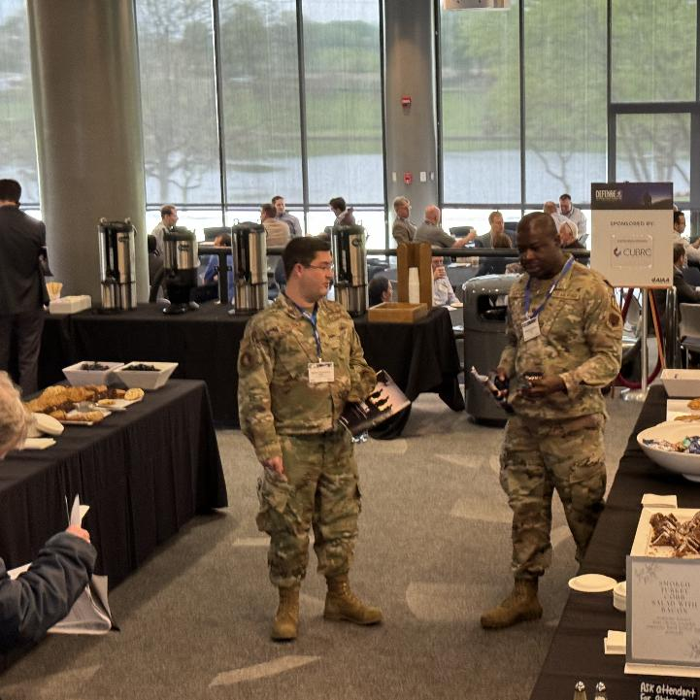
DEFENSE Forum 17–19 March, Laurel, Maryland
Theme: “Driving Accelerated Innovation to the Warfighter”
97 technical presentation (-40% from 2025)
449 attendees (-5% from 2025)
Sponsorships +11% over 2025
Notable speakers:
The Hon. Joseph Jewell, Assistant Secretary of War for Science and Technology
Eliahu Niewood, Director, Air Force Integrated Capabilities Office
Gupartap “GP” Sandhoo, Acting Director, Space Development Agency

Slide 63

ASCEND 19–21 May, Washington, D.C.
Theme: “Building Our Sustainable Off World Future”
Call for Content:
234 abstracts, -10% from 2025
128 sessions, +11% from 2025
136 technical presentations planned +3.6% from 2025
144 sessions with approx. 200 speakers
8 event partners: CSF, Aerospace Corp., BryceTech, ISS National Lab, NASM, Novaspace, SFA, SGAC
Special features: Classified Day, Global Leaders Space Exploration Forum
RECORD ATTENDANCE!
>1700

Slide 64
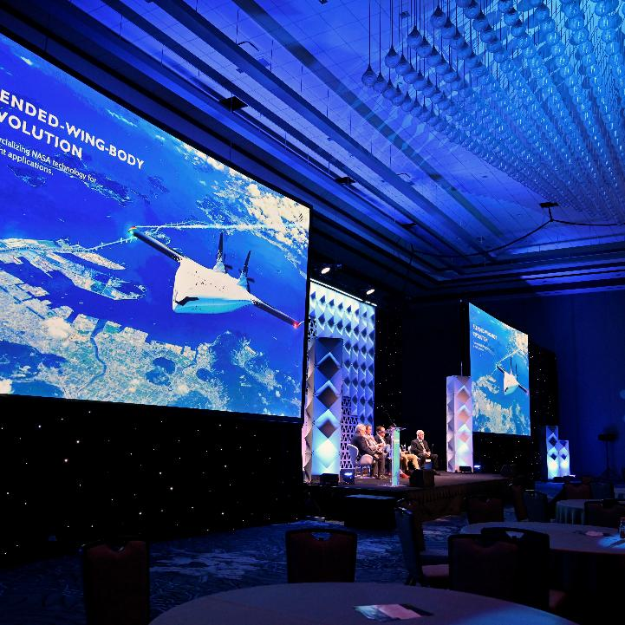
AVIATION Forum 8–12 June, San Diego, California
Theme: “From Velocity to Altitude…Accelerating Towards Tomorrow”
Call for Content:
1,219 abstracts, - 10.6% from 2025
85 sessions, consistent with 2025
906 technical presentations planned
Features Electric Propulsion and Advanced Technologies Symposium (formerly EATS)
Will include recognition of Premier Awards & Awards Ceremony
Partners: SFTE, H2Aero, SAE AE-5H Standards Committee

Slide 65




Future Forum and Event Dates
Hyatt Regency Orlando
through 2028
Phoenix: January 8-12, 2029
Seattle: January 7-11, 2030
Phoenix: January 6-10, 2031
Seattle: January 5-9, 2032
Washington Hilton:
o May 18-20, 2027
o June 19-21, 2028
Manchester Grand Hyatt, San Diego through 2028
Looking at locations and venues for 2029
and beyond
Priority on cities with strong aviation presence and deconflicting dates with major industry events
65
65

Slide 66


International Astronautical Congress (IAC) 2029
AIAA hopes to host IAC in 2029
Host city: Houston, Texas
Bid package submitted in April 2026
A successful bid will affect ASCEND 2029 plans

Slide 67
Important Notes
SciTech Call for Content Closes 21 May
All non-paper technical sessions submitted through Call for Sessions
DEFENSE Call for Briefings Opened 12 May, Closes 13 August
ASCEND Call for Content Opens 21 July
Call for Papers Due to Kim Grant 9 June
AVIATION Call for Content Opens 15 September
Call for Papers Due to Kim Grant 6 August

Slide 68
Miscellaneous Updates
68
68

Slide 69
Important Dates to Remember
January
READ/IOD/TAD and Council Meetings
January 31
Committee rosters due to HQ and Director
February 27
Annual Report online submission
April 1
TC Charter refresh deadline
April 15
Associate Fellow Nominations Due
May 15
Associate Fellow References
May 17-18 - Spring Business Meetings
READ/IOD/TAD/Council/Board Meetings
June 11
Fellow/Honorary Fellow Nomination Due
July
Nominations for AIAA Board of Trustees
July 1
Fellow/Honorary Fellow References
August
READ/IOD/TAD/Council/Board Meetings
September 1
Aerospace America YIR Article (YIR) to AIAA Headquarters
Oct/Nov
TAD Meeting w/TC Chair Roundtable
Council Meeting
As Appropriate
AIAA Award Recipient Recommendations
Senior Member Applications (anytime)
Upcoming
Deadlines!
Questions or Need Help?
Contact AIAA Staff via committeehelp@aiaa.org

Slide 70
New TC Member Cycle
IMPORTANT DATES TO REMEMBER
1 Sept Online application portal opens
~15 Oct Online application portal closes
~15 Oct Judge Teams and Judge Team Managers get access
31 Jan All applications have final approval/decline in online portal
31 Jan Rosters due to AIAA Staff and Group Director
Reminder: Request TAD Group Director approval to exceed the 50-member roster limit
Please be sure to meet these dates!
70

Slide 71
QUESTIONS?
stephen.blanchette@aero.org

Slide 73
BACKUP
73
73

Slide 74
SMG Refresh – Potential Gaps Under Consideration
More Investigation/Discussion Needed

Slide 75
Communications and Space Data Infrastructure (CSDI TC)
Advance resilient space and ground communications architectures supporting missions across Earth orbit, cislunar, and deep-space environments. Scope includes RF, optical/laser, and quantum communications, crosslinks and inter-satellite networking, delay-/disruption-tolerant networking (DTN), software-defined and reconfigurable payloads, and spectrum strategy. The TC also covers ground-segment systems and integration, including antennas, gateways, network orchestration, cybersecurity, and edge and space/ground data-center infrastructure that enable mission operations, scientific return, and commercial services.
Payload sensing and mission operations remain with EPSA and MORR, respectively. Spacecraft platform design remains with SSCCS.
Scope being considered for Communications TC in ISG

Slide 76
Earth and Planetary Science and Applications (EPSA TC)
Advance missions and data exploitation for Earth observation and planetary exploration. Focus areas include atmospheric and environmental monitoring, agriculture and food systems, hazards and disaster response applications (weather, wildfires, etc.), lunar/planetary surface and subsurface sensing missions (e.g., SAR, LiDAR, IR, hyperspectral), and science-to-application transition. Addresses tasking, calibration/validation, and application-driven requirements.
Spacecraft platforms and commoditized buses remain with SSCCS
Mission equipment remains with SSIF in ISG
Comms and data infrastructures remain with CSDI (or equivalent) in ISG

Slide 77
Lunar Surface & Cislunar Exploration (LSCE TC)
Advance the technologies, mission architectures, and operational concepts that enable sustained scientific, commercial, and human activities across the cislunar domain and on the lunar surface. The TC focuses on exploration systems, mobility and surface operations, navigation and transfer architectures, landing and ascent systems, science payload deployment, campaign planning, and mission integration elements supporting long-duration presence. It emphasizes interoperability, international and commercial coordination, and alignment with long-term space infrastructure, logistics, and resource utilization strategies.
Position, navigation, and timing (PNT), an area currently not addressed directly within TAD, could be represented here, perhaps initially as a Working Group.
Space resources utilization remain with SRU TC
Coordinates with CSDI TC for communications infrastructure and SAH TC for habitats
Coordinates with MORR for mission operations

Slide 78
In-Situ Servicing, Assembly, and Manufacturing (ISAM TC)
Advance technologies, architectures, standards, and operations enabling autonomous and crew-assisted assembly, manufacturing, inspection, repair, refueling, reconfiguration, and lifetime extension of space systems. Includes modular structures, robotic manipulation, in-situ fabrication using Earth-supplied or ISRU feedstock, standardized interfaces, materials processing, quality assurance, and autonomous control frameworks.
Coordinates with SRE for feedstock and logistics integration, and with MORR for proximity operations and safety-of-flight rules and procedures

Slide 79
Space Domain Awareness and Orbital Sustainability (SDAOS)
Advance space domain awareness and space traffic management across LEO-to-cislunar regimes, including sensing techniques (optical, radar, RF), cataloging, characterization, conjunction assessment, maneuver coordination, and decision support. Promote design-for-demisability, end-of-life planning, debris mitigation and remediation (including tether and drag augmentation concepts), stewardship norms, and ethics of orbital sustainability.
Interfaces with MORR on operational procedures and with LVES on vehicle design features enabling SDA/STM compliance
Coordinates with CSDI on data management/decision support
Contributes to the Sustainability Integration Committee in the Integration and Outreach Division (IOD) on full-spectrum space sustainability issues
Debris applications of tethers would be captured here

